Slide 1
Email Marketing Analysis

Slide 2
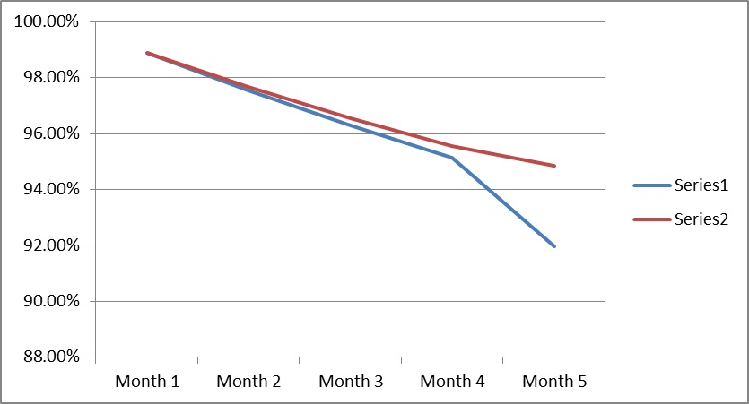
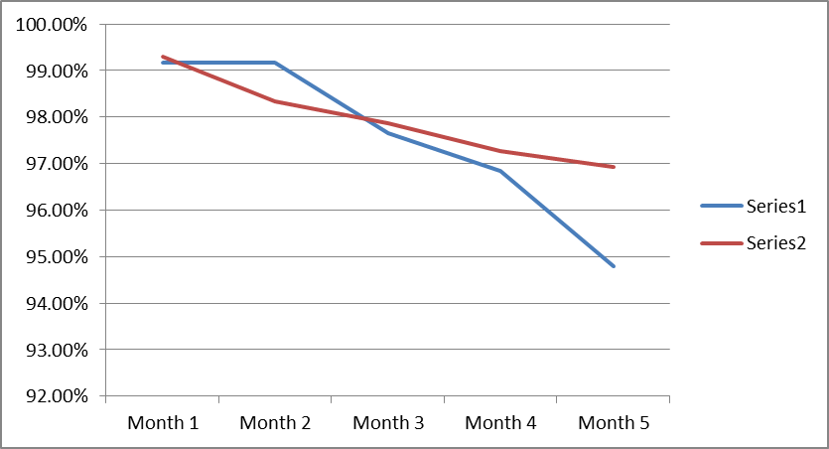
InfoPro Based Performance (Customer Retention)
Customers Retained | Month 1 | Month 2 | Month 3 | Month 4 | Month 5
858 | 0.38 | -7.43 | -14.94 | -25.97 | -168.54
Customers Retained | Month 1 | Month 2 | Month 3 | Month 4 | Month 5
865 | -9.66 | 69.08 | -17.52 | -34.52 | -172.61

Slide 3
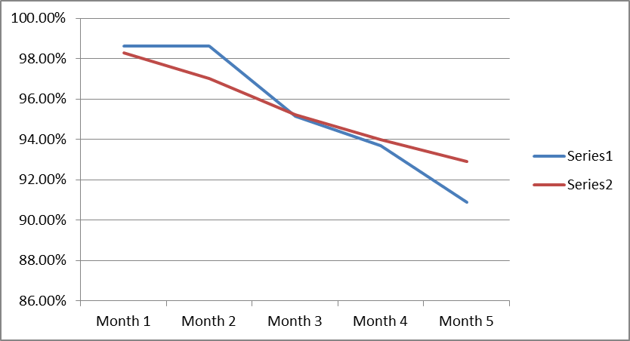
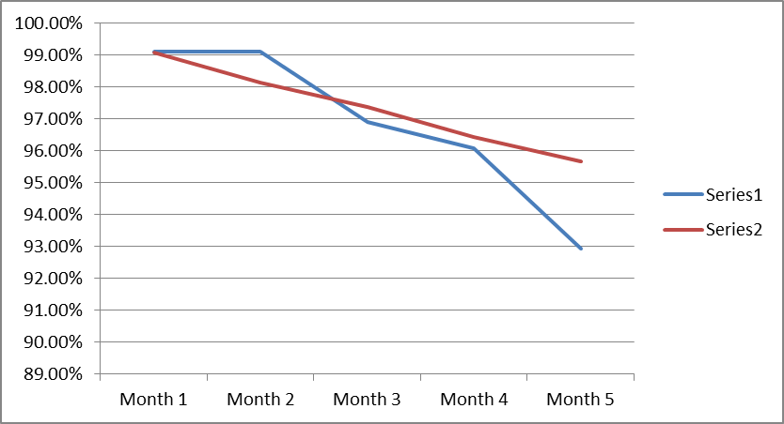
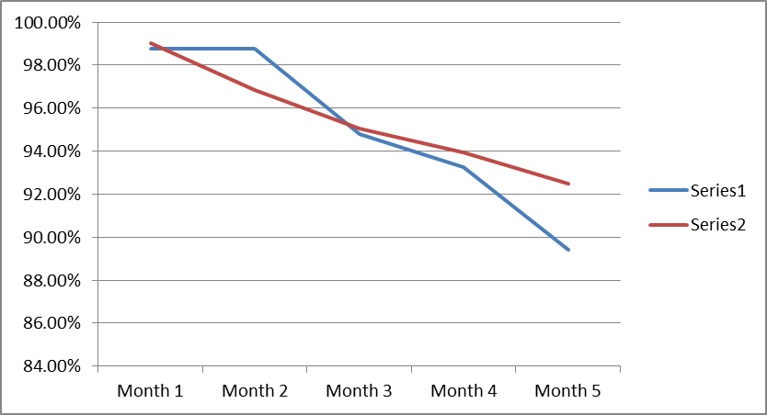
InfoPro Based Performance (Customer Retention)
 | Month 1 | Month 2 | Month 3 | Month 4 | Month 5
894 | 18.77 | 82.13 | -3.48 | -13.15 | -99.74
Customers Retained | Month 1 | Month 2 | Month 3 | Month 4 | Month 5
899 | -11.44 | 77.26 | -9.60 | -27.24 | -119.82
Customers Retained | Month 1 | Month 2 | Month 3 | Month 4 | Month 5
923 | 1.79 | 51.39 | -23.73 | -17.79 | -139.29

Slide 4
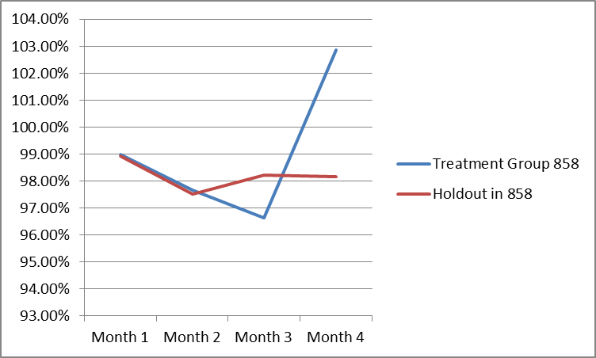
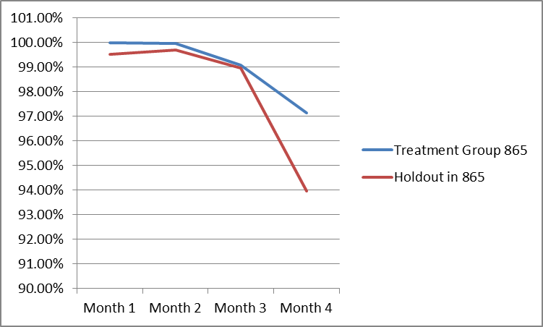
InfoPro Based Performance (Revenue Retention)
Revenue Retention | Month 1 | Month 2 | Month 3 | Month 4
858 | $ 96.47 | $ 215.40 | $ (2,390.01) | $ 7,242.04
Revenue Retained | Month 1 | Month 2 | Month 3 | Month 4
865 | $ 1,303.44 | $ 728.66 | $ 280.31 | $ 8,212.43

Slide 5
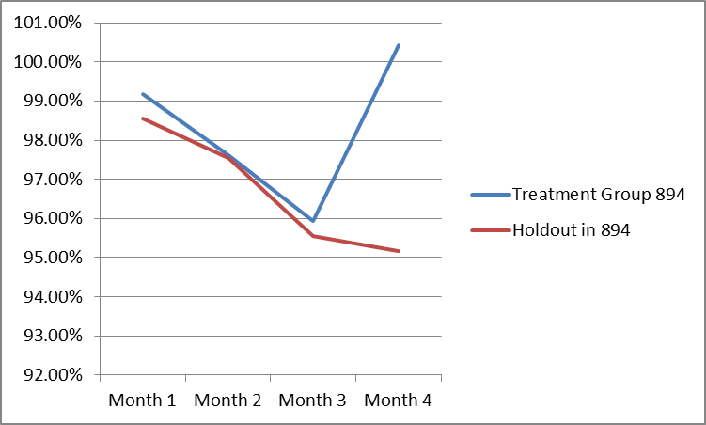
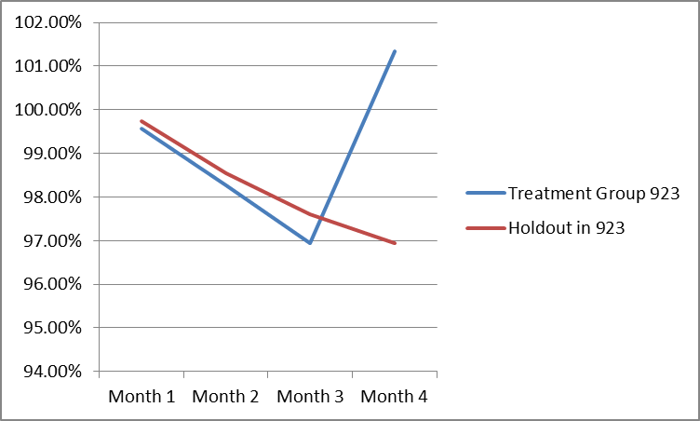
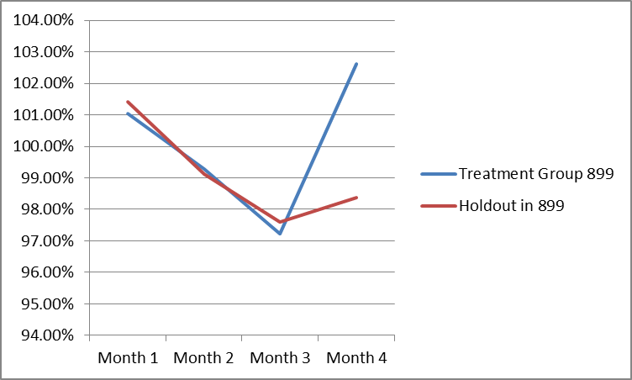
InfoPro Based Performance (Revenue Retention)
Revenue Retained | Month 1 | Month 2 | Month 3 | Month 4
894 | $ 534.14 | $ 65.79 | $ 318.09 | $ 4,429.18
Revenue Retained | Month 1 | Month 2 | Month 3 | Month 4
899 | $ (245.09) | $ 93.60 | $ (230.27) | $ 2,686.29
Revenue Retained | Month 1 | Month 2 | Month 3 | Month 4
923 | $ (168.30) | $ (264.53) | $ (642.81) | $ 4,229.21

Slide 6
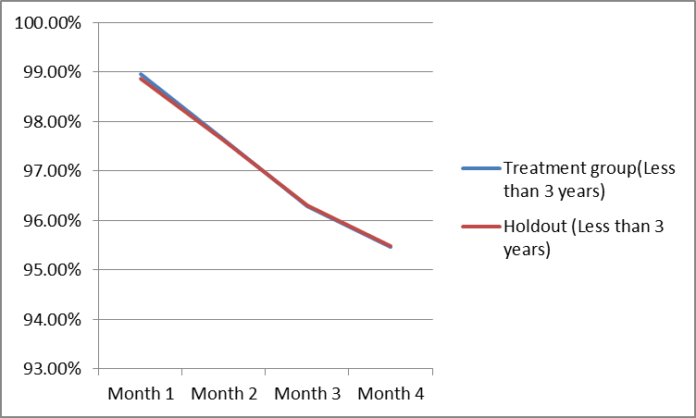
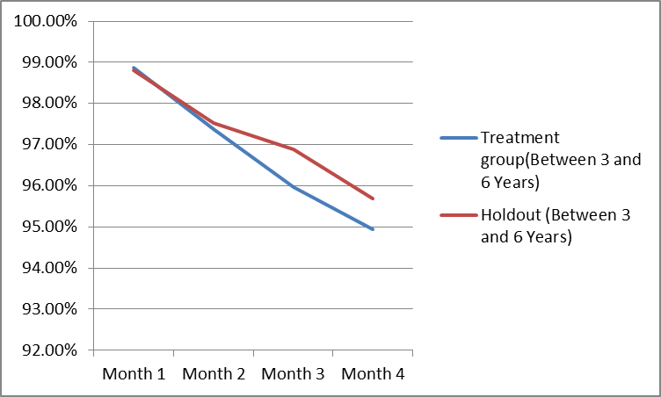
Tenure Based Performance (Customer Retention)
Customer Retention | Month 1 | Month 2 | Month 3 | Month 4
Under 3 years | 7.01 | 1.43 | -1.52 | -1.02
Customer Retained | Month 1 | Month 2 | Month 3 | Month 4
Between 3 and 6 years | 1.00 | -2.74 | -17.71 | -14.26

Slide 7
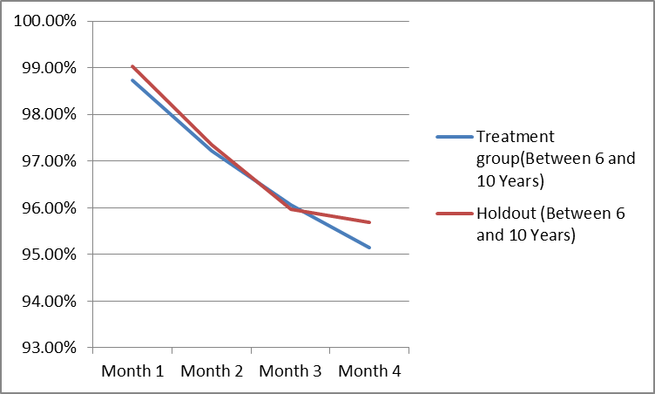
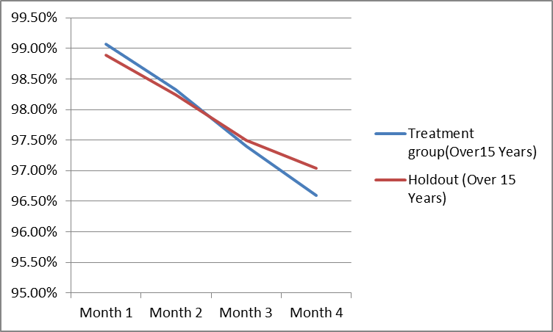
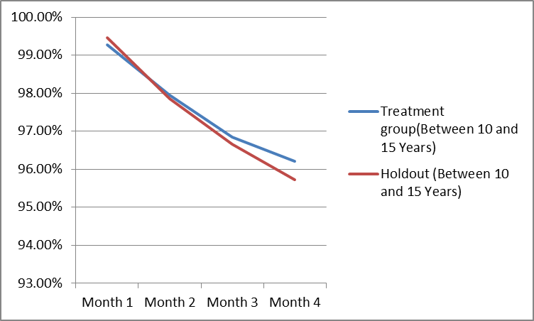
Tenure Based Performance (Customer Retention)
Customer Retained | Month 1 | Month 2 | Month 3 | Month 4
Between 6 and 10 Years | -4.40 | -2.01 | 1.26 | -7.73
Customer Retained | Month 1 | Month 2 | Month 3 | Month 4
Between 10 and 15 years | -4.00 | 1.84 | 4.19 | 10.46
Customer Retained | Month 1 | Month 2 | Month 3 | Month 4
Over 15 Years | 5.38 | 2.55 | -3.00 | -12.81

Slide 8
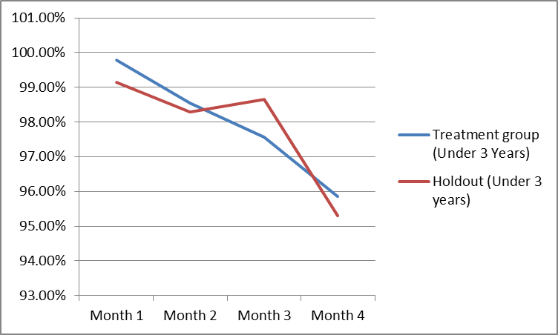
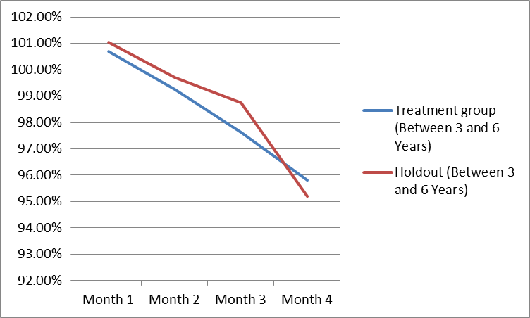
Tenure Based Performance (Revenue Retention)
Revenue Retention | Month 1 | Month 2 | Month 3 | Month 4
Under 3 years | $ 1,208.23 | $ 185,269.79 | $ (1,984.18) | $ 996.30
Revenue Retained | Month 1 | Month 2 | Month 3 | Month 4
Between 3 and 6 years | $ (190.92) | $ 54,247.90 | $ (598.29) | $ 312.93

Slide 9
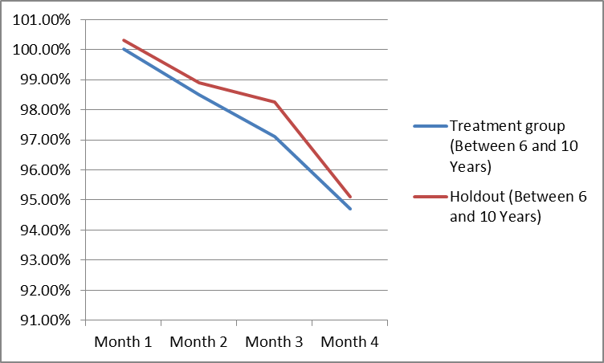
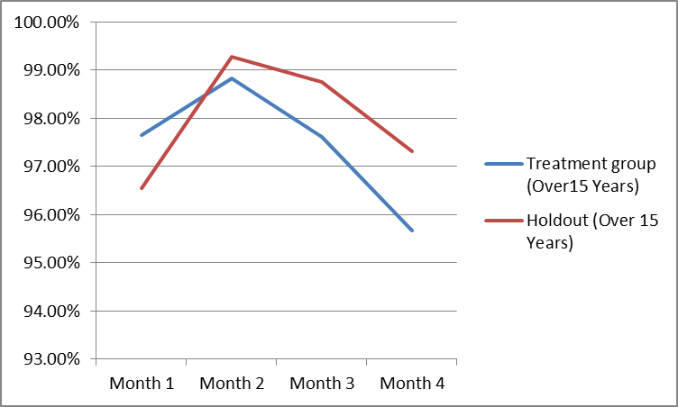
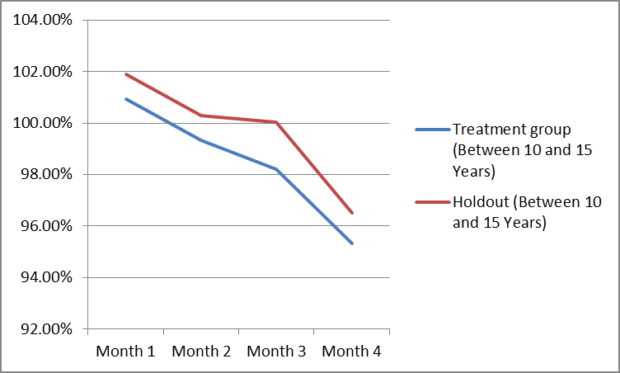
Tenure Based Performance (Revenue Retention)
Revenue Retained | Month 1 | Month 2 | Month 3 | Month 4
Between 6 and 10 Years | $ (134.25) | $ 46,353.06 | $ (518.25) | $ (175.57)
Revenue Retained | Month 1 | Month 2 | Month 3 | Month 4
Between 10 and 15 years | $ (726.86) | $ 75,673.89 | $ (1,374.29) | $ (860.45)
Revenue Retained | Month 1 | Month 2 | Month 3 | Month 4
Over 15 Years | $ 1,027.42 | $ 95,106.54 | $ (1,078.00) | $ (1,499.63)

Slide 10
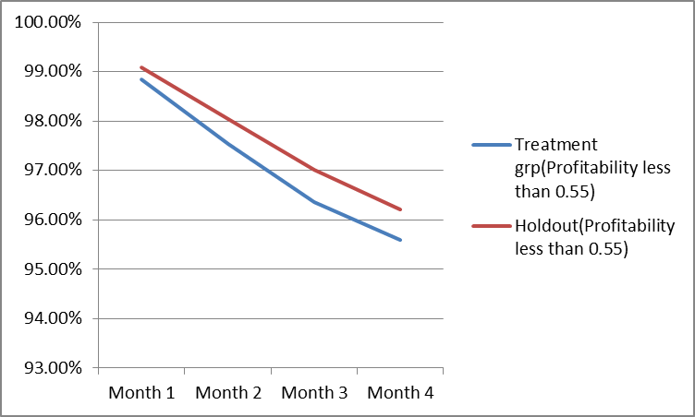
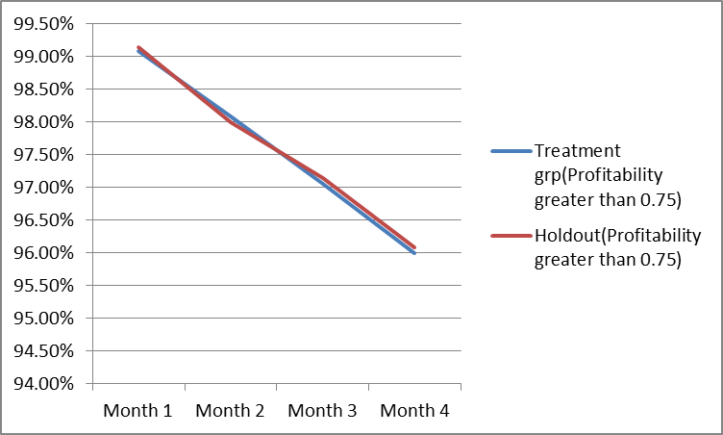
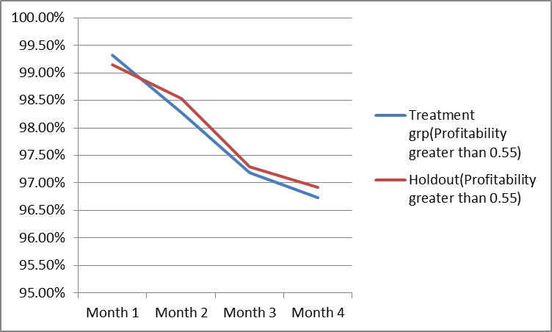
Profitability Based Performance (Customer Retention)
Customer Retention | Month 1 | Month 2 | Month 3 | Month 4
Profitability less than 0.55 | -8.24 | -16.83 | -21.55 | -20.16
Customer Retained | Month 1 | Month 2 | Month 3 | Month 4
Profitability greater than 0.55 | 5.79 | -8.64 | -3.74 | -6.13
Customer Retained | Month 1 | Month 2 | Month 3 | Month 4
Profitability greater than 0.75 | -1.83 | 2.21 | -2.02 | -2.35

Slide 11
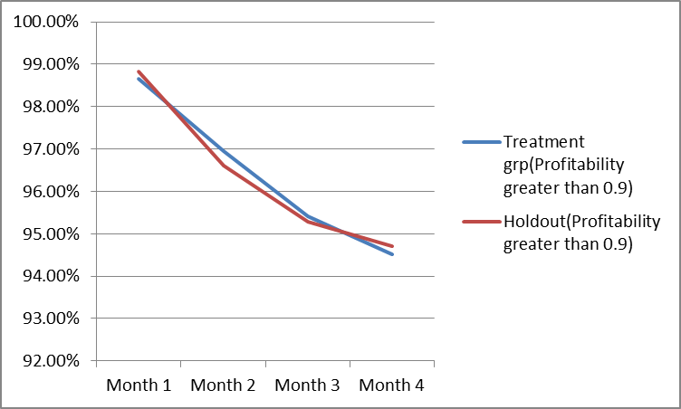
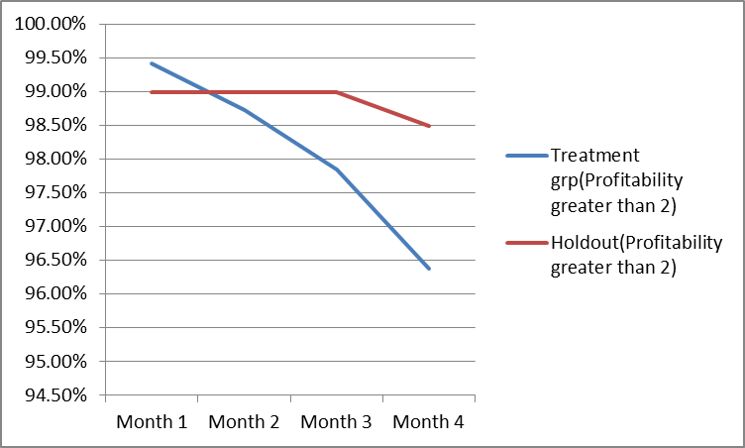
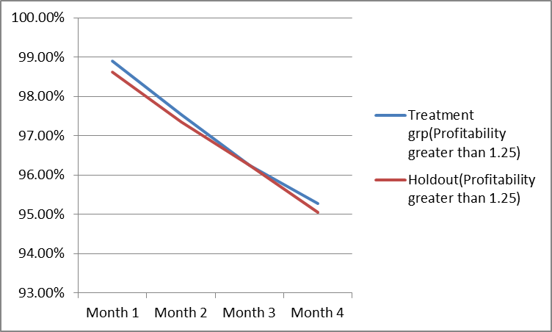
Profitability Based Performance (Customer Retention)
Customer Retention | Month 1 | Month 2 | Month 3 | Month 4
Profitability greater than 0.9 | -4.97 | 10.50 | 3.64 | -5.70
Customer Retained | Month 1 | Month 2 | Month 3 | Month 4
Profitability greater than 1.25 | 7.98 | 5.53 | -0.03 | 6.27
Customer Retained | Month 1 | Month 2 | Month 3 | Month 4
Profitability greater than 2 | 2.26 | -1.42 | -6.15 | -11.32

Slide 12
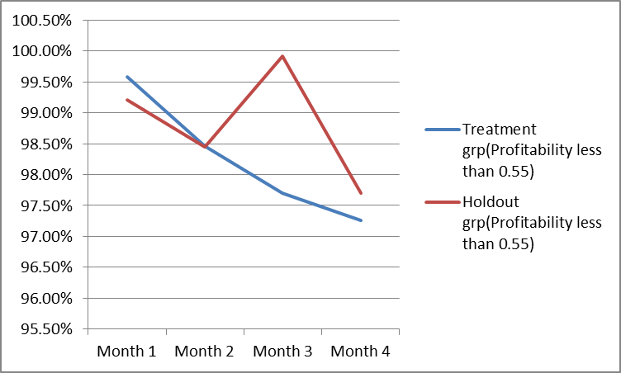
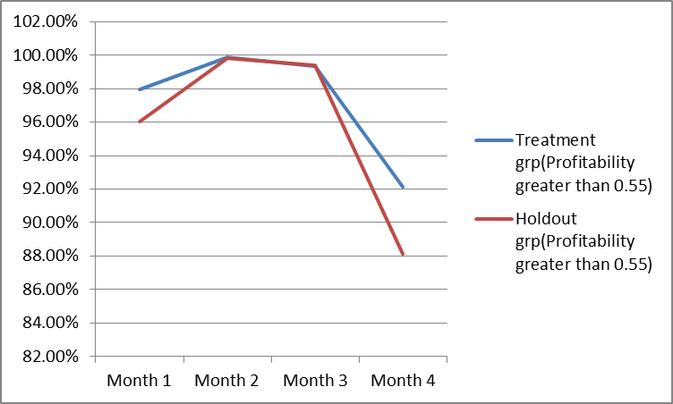
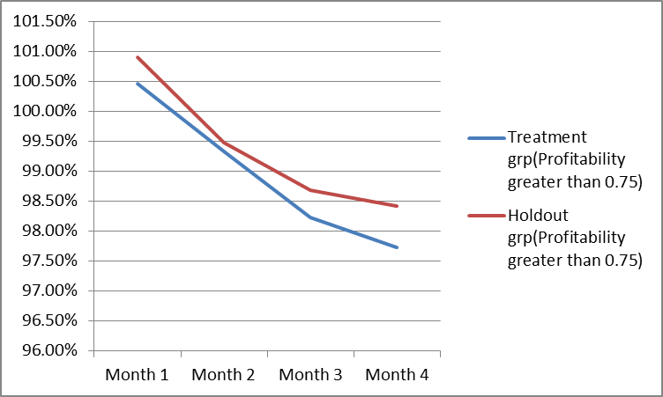
Profitability Based Performance (Retention Retention)
Revenue Retention | Month 1 | Month 2 | Month 3 | Month 4
Profitability less than 0.55 | $ 314.91 | $ 17.11 | $ (1,817.88) | $ (350.72)
Revenue Retention | Month 1 | Month 2 | Month 3 | Month 4
Profitability greater than 0.55 | $ 1,604.90 | $ 62.54 | $ (75.27) | $ 2,980.88
Revenue Retention | Month 1 | Month 2 | Month 3 | Month 4
Profitability greater than 0.75 | $ (291.94) | $ (96.50) | $ (290.81) | $ (437.31)

Slide 13
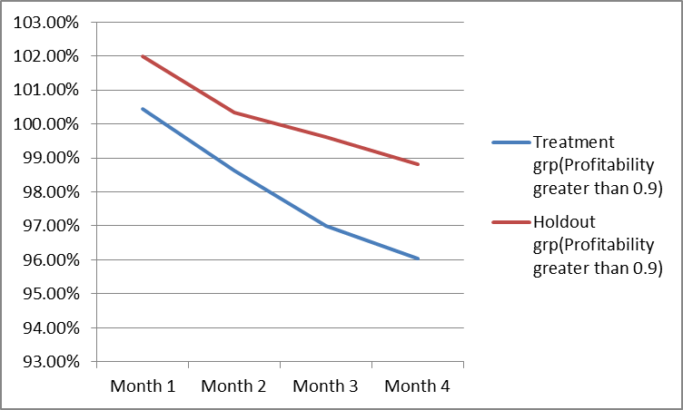
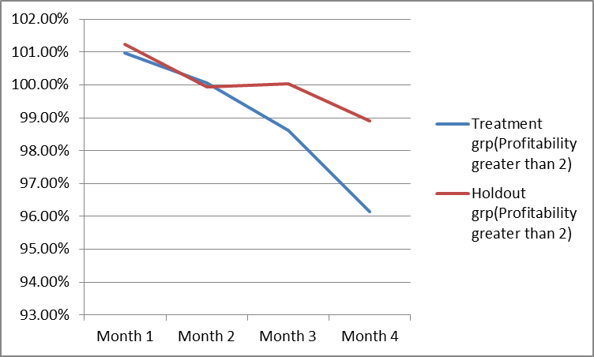
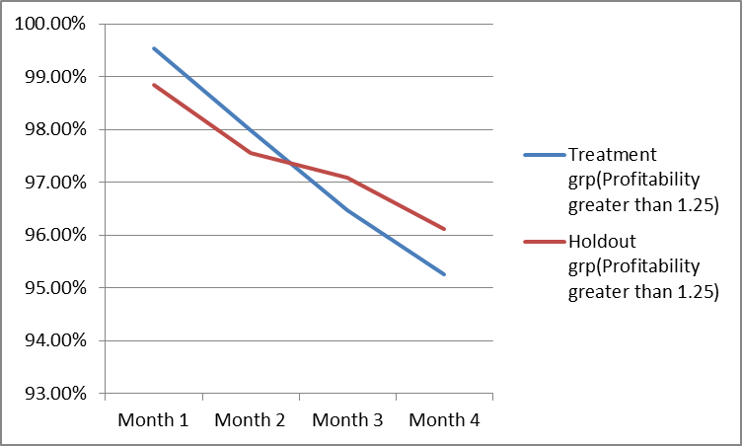
Profitability Based Performance (Retention Retention)
Revenue Retention | Month 1 | Month 2 | Month 3 | Month 4
Profitability less than 0.9 | $ (1,436.48) | $ (1,566.21) | $ (2,343.29) | $ (2,455.32)
Revenue Retention | Month 1 | Month 2 | Month 3 | Month 4
Profitability greater than 1.25 | $ 814.99 | $ 481.07 | $ (688.36) | $ (974.12)
Revenue Retention | Month 1 | Month 2 | Month 3 | Month 4
Profitability greater than 2 | $ (47.72) | $ 18.95 | $ (251.71) | $ (478.70)

Slide 14
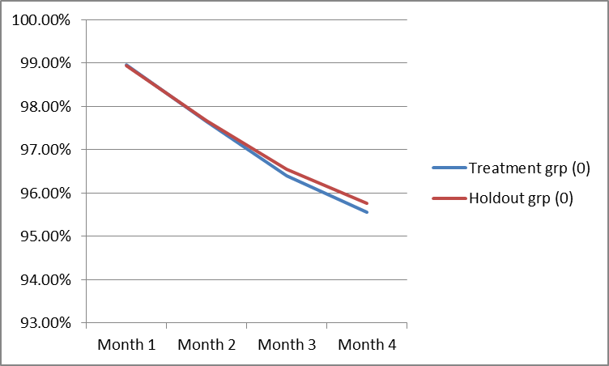
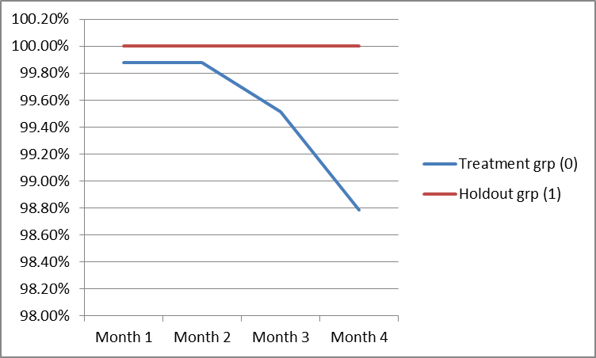
Future Rate Based Performance (Customer Retention)
Customer Retention | Month 1 | Month 2 | Month 3 | Month 4
0 | 2.27 | -3.03 | -23.74 | -32.60
Customer Retained | Month 1 | Month 2 | Month 3 | Month 4
1 | -0.63 | -0.63 | -2.51 | -6.24

Slide 15
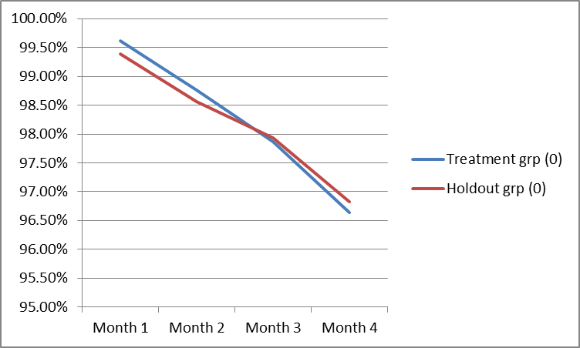
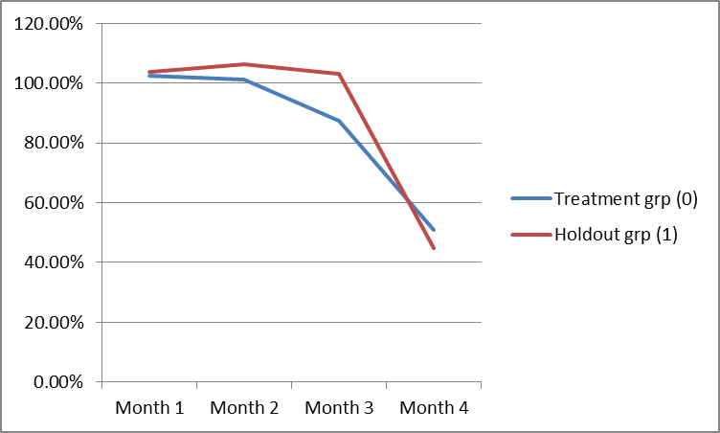
Future Rate Based Performance (Customer Retention)
Revenue Retained | Month 1 | Month 2 | Month 3 | Month 4
0 | $ 1,055.57 | $ 880.83 | $ (281.37) | $ (803.32)
Revenue Retained | Month 1 | Month 2 | Month 3 | Month 4
1 | $ (170.23) | $ (604.51) | $ (1,567.47) | $ 261.72

